Slide 1
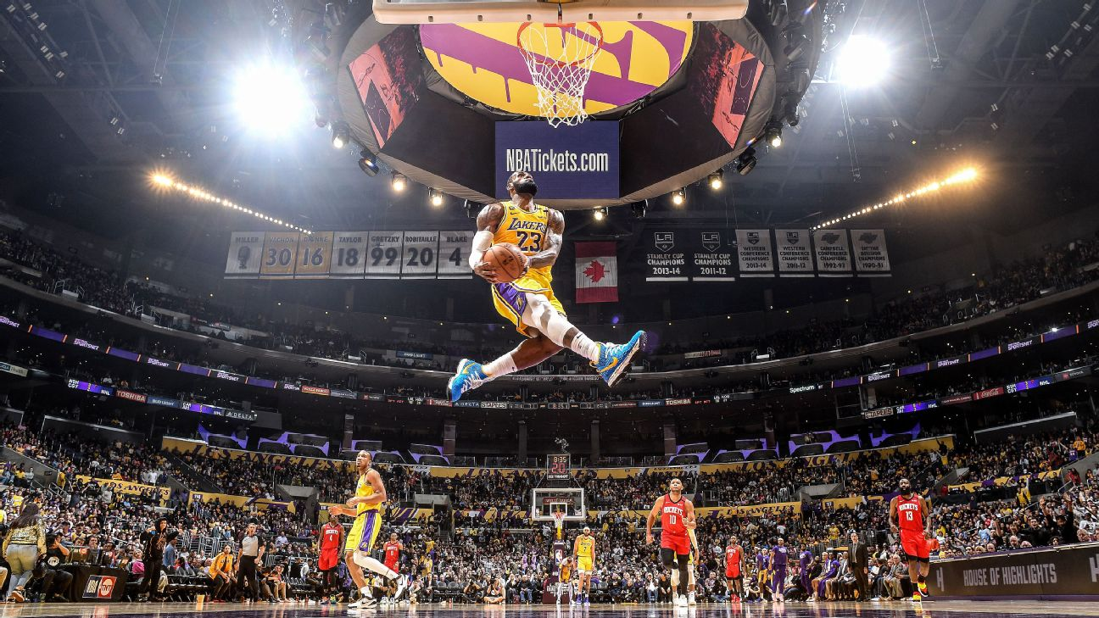
NBA Player Clustering 2019-2020 NBA Season Tony Ramsett Data Practicum 2 Regis University

Slide 2



Project Description
Research Question
Data sets Used
Models Utilized
How were NBA players similar and different from a statistical perspective before COVID-19 forced the season to shut down?
Three data sets used from basketball-reference.com
Shooting Statistics
One data set from NBA.com
Traditional (Box Score) Statistics
Advanced Statistics
Defensive Statistics
Unsupervised Learning Models
K-Means Clustering
Hierarchical Clustering Analysis (HCA)

Slide 3
Project Timeline
8-week project spanning from 06/28/20 – 08/23/20 followed the Data Science Lifecycle
Week 1
Week 2
Week 3
Week 4
Week 5
Week 6
Week 7
Week 8
Business Understanding
Data Mining
Data Cleaning
Data Exploration
Feature Engineering
Predictive Modeling
Data Visualization

Slide 4




Unsupervised Learning
Examples of unsupervised Learning
What is it?
fff
Kmeans – what is it/why important
HCA – what is it/why important
PCA – what is it/why important
Others out there …
Significance/Purpose
Disadvantages of unsupervised learning
fff
fff

Slide 5
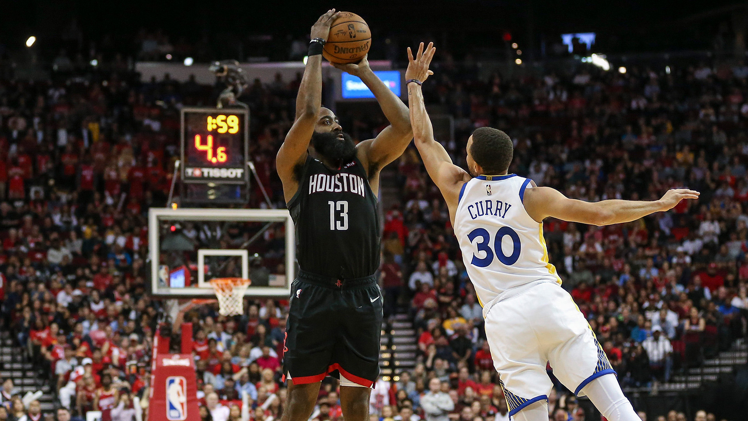
Offensive Scoring Clusters

Slide 6
Data Set Description
Column Used for Clustering | Column Removed
Data Set Dimensions: 514 rows x 27 columns
Row Number
Player = Player Name
Tm = Team Player Plays For
Age = Age of Player
G = Games Played
MP = Total Minutes Played
FG. = Field Goal Percentage
Dist. = Average distance (feet) of Field Goal Attempted
X2P_X.of.FGA.by.Distance = Percent of Two-Point Field Goals Attempted
X0.3P_X.of.FGA.by.Distance = Percent of Field Goals Attempted From 0-3 Feet
X3.10P_X.of.FGA.by.Distance = Percent of Field Goals Attempted From 3-10 Feet
X10.16P_X.of.FGA.by.Distance = Percent of Field Goals Attempted From 10-16 Feet
X16.3P_X.of.FGA.by.Distance = Percent of Field Goals Attempted From 16-30 Feet
X3P_X.of.FGA.by.Distance = Percent of Three-Point Field Goals Attempted
X2P_FG.by.Distance = Percent of Two-Point Field Goals Made
X0.3_FG.by.Distance = Percent of Field Goals Made From 0-3 Feet
X3.10_FG.by.Distance = Percent of Field Goals Made From 3-10 Feet
X10.16_FG.by.Distance = Percent of Field Goals Made From 10-16 Feet
X16.3P_FG.by.Distance = Percent of Field Goals Made From 16-30 Feet
X3P_FG.by.Distance = Percent of Three-Point Field Goals Made
X2P_of.FG.Ast’d = Percent of Two-Point Field Goals Made With Assist
X3P_of.FG.Ast’d = Percent of Three-Point Field Goals Made With Assist
X.FGA_Dunks = Percent of Dunks Attempted
X_Dunks = Number of Dunks Made
X.3PA_Corner.3s = Percent of Corner 3’s Attempted
X3P._Corner.3s = Percent of Corner 3’s Made
Adjustments
Data Cleaning
Data set contained 467 NA values
Converted to values of ‘0’
Data narrowed down to top 100 players by minutes played (G/MP > 29.35 minutes per game) for cluster analysis
All data values normalized for cluster accuracy
Feature Engineering
Minutes Per Game (G/MP) used for sub-setting then removed
Final Data Set Dimensions
100 rows x 21 columns
Source: https://www.basketball-reference.com/leagues/NBA_2020_shooting.html

Slide 7
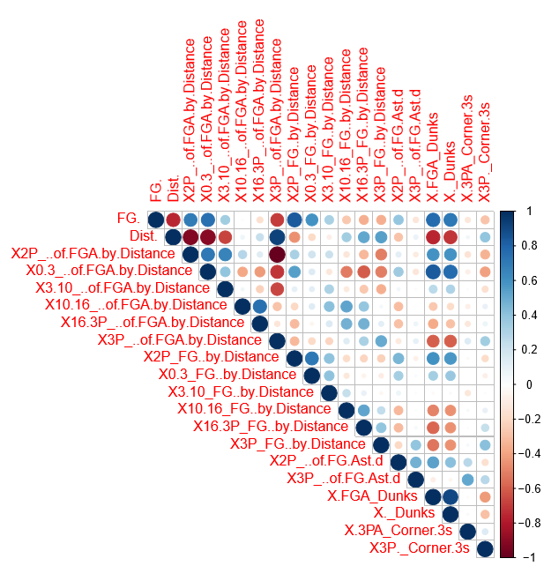
Corrplot
Takeaways
Takeaways

Slide 8
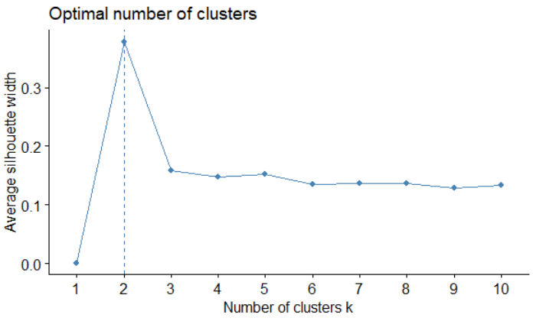
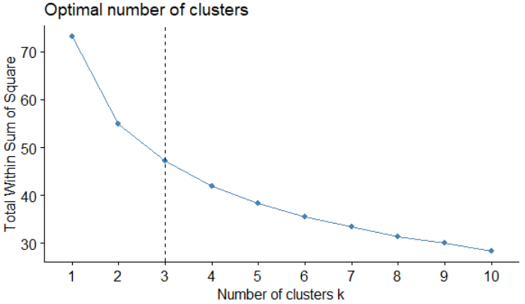
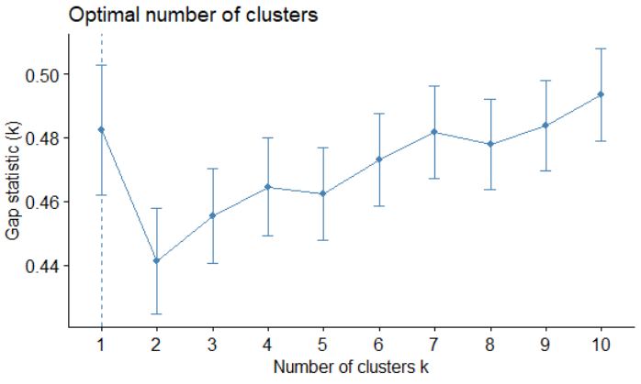
Cluster Optimization
Tagish line – describe different methods
Elbow Method
Silhouette Method
Gap Statistic Method
explain method
explain method
explain method
Total clusters and why----

Slide 9
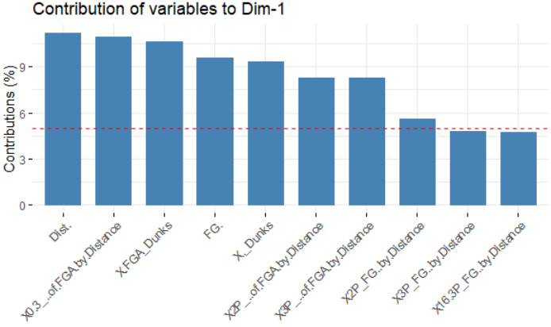
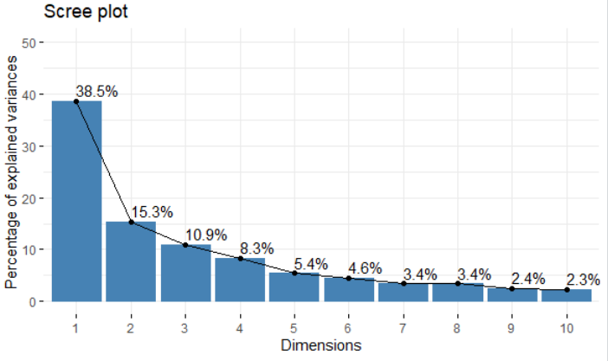
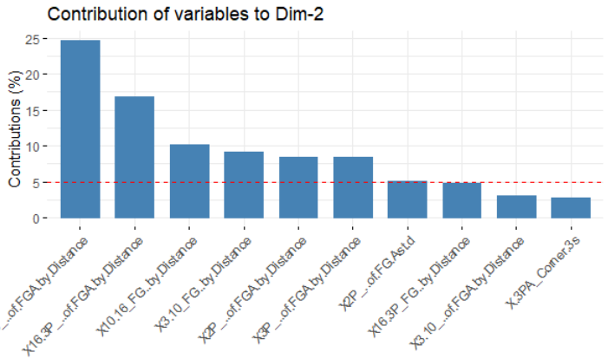
PCA

Slide 10
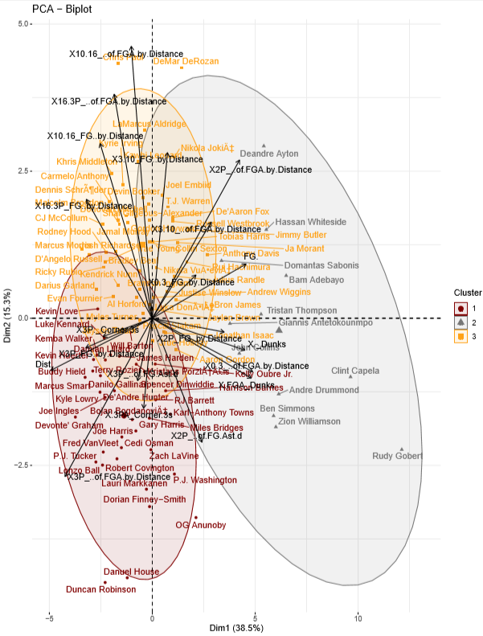
PCA

Slide 11
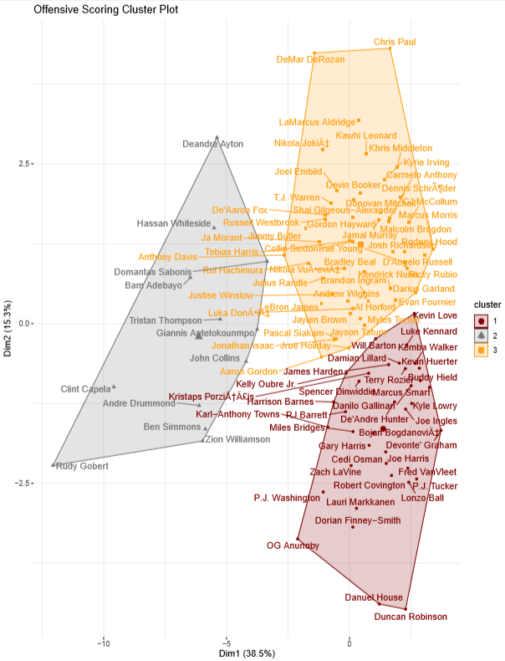
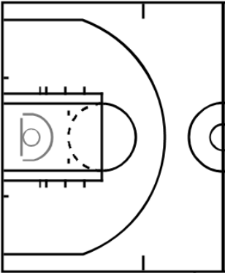
Cluster 1
Cluster 2
Cluster 3

Slide 12
Cluster Outcomes
Cluster 1 - Name
Cluster 2 - Name
Cluster 3 - Name
Describe playing style of cluster
Describe playing style of cluster
Describe playing style of cluster
Table with significant variables
Table with significant variables
Table with significant variables

Slide 13
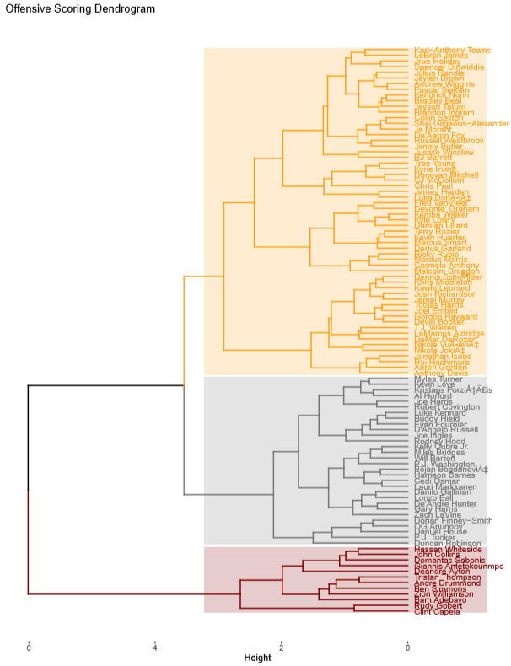
Compare/contrast to k means

Slide 14
Conclusions

Slide 15
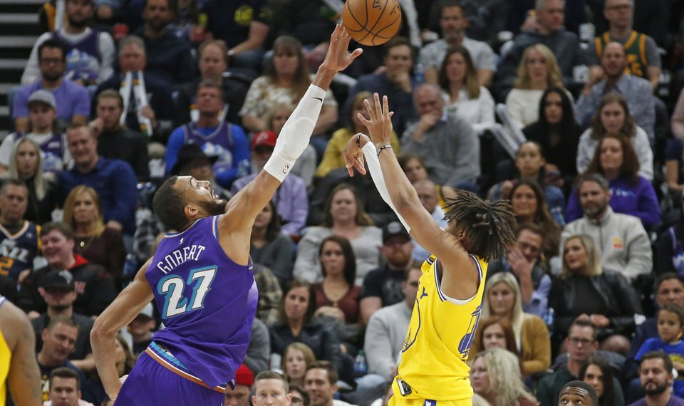
Defensive Performance Clusters

Slide 16
Data Set Description
Outlook
Adjustments
Column Used for Clustering | Column Removed
Data Cleaning
Data set contained zero NA values
Data narrowed down to top 100 players by minutes played (> 29.35 minutes) for cluster analysis
All data values normalized for cluster accuracy
Feature Engineering
No additional columns added to data set
Final Data Set Dimensions
100 rows x 15 columns
Row Number
Player = Player Name
Team = Team Player Plays For
Age = Age of Player
GP = Games Played
W = Team Wins
L = Team Losses
MIN = Minutes Played Per Game
DEFA.RTG = Defensive Rating
DREB = Defensive Rebounds Per Game
DREB. = Defensive Rebound Percentage
X.DREB = Percent of Team’s Defensive Rebounds
STL = Steals Per game
STL. = Percent of Team’s Steals
BLK = Blocks Per Game
X.BLK = Percent of Team’s Blocks
OPPA.PTS_OFF.TOV = Opponent Points Off Turnovers
OPPA.PTS.2ND.CHANCE = Opponent 2nd Chance Points
OPPA.PTS.FB = Opponent Fast Break Points
OPPA.PTS.PAINT = Opponent Points in the Paint
DEF.WS = Defensive Win Shares
Data Set Dimensions: 514 rows x 21 columns
Source: https://stats.nba.com/players/defense/?sort=DEF_WS&dir=-1

Slide 17
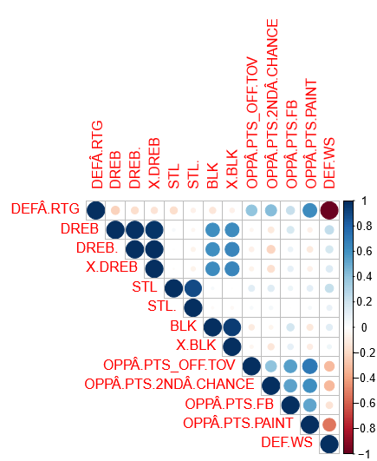
Correlation Plot
Insights
Positive Correlations
Defensive Rebounds Per Game and Defensive Rebound Percentage
Defensive Rebound variables with Blocks variables
Opponent Points variables
Negative Correlations
Defensive Rating and Defensive Win Shares
The correlation plot shows several interesting correlations between variables within the data set

Slide 18
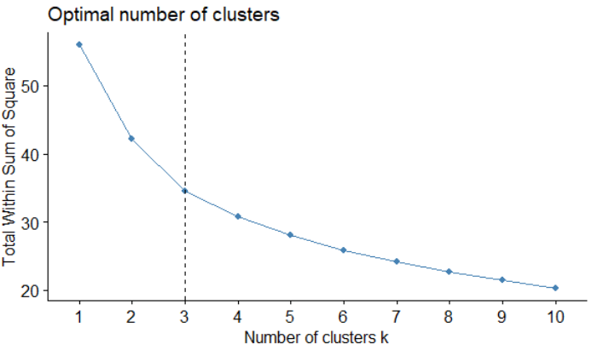
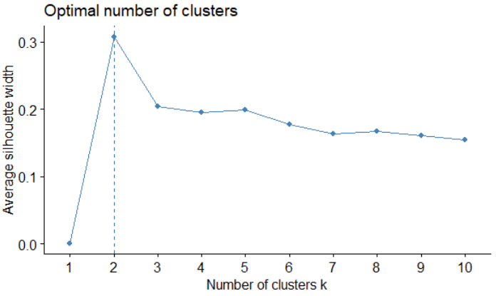
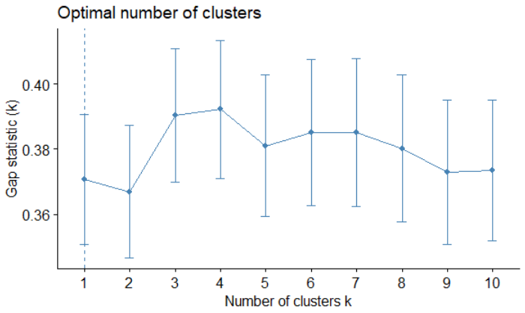
Cluster Optimization
Tagish line – describe different methods
Elbow Method
Silhouette Method
Gap Statistic Method
What is it/why used
What is it/why used
What is it/why used
Total clusters and why----

Slide 19
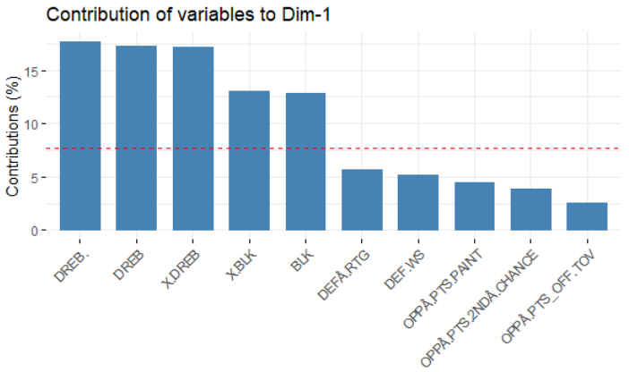
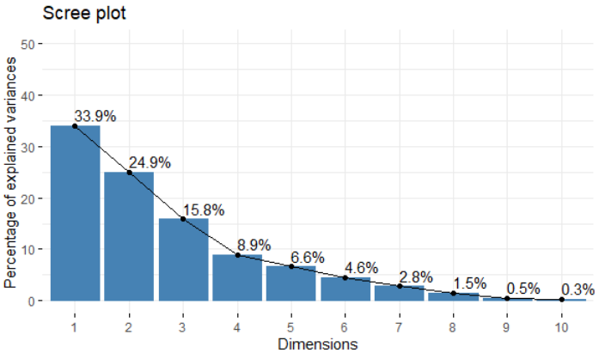
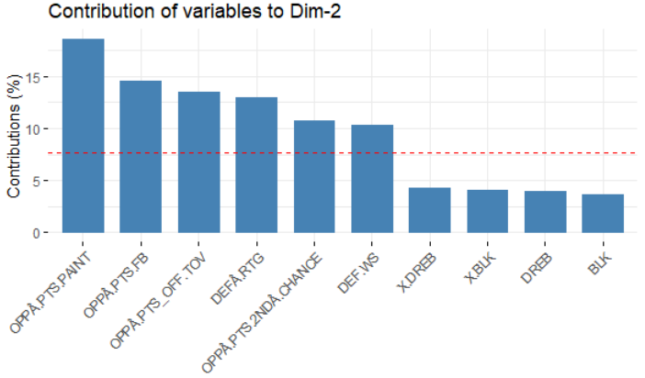
PCA

Slide 20
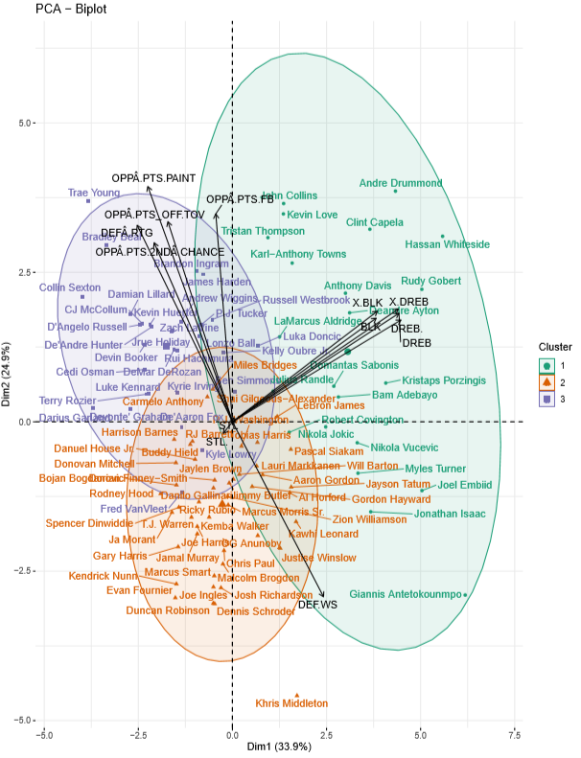
PCA

Slide 21
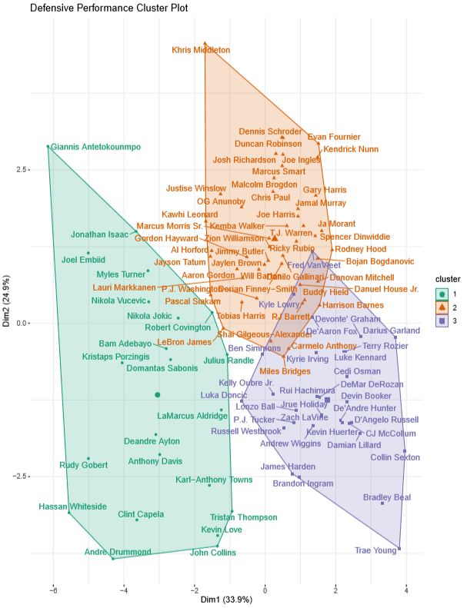
Cluster 1
Cluster 2
Cluster 3

Slide 22
Cluster Outcomes
Cluster 1 - Name
Cluster 2 - Name
Cluster 3 - Name
Describe playing style of cluster
Describe playing style of cluster
Describe playing style of cluster
Table with significant variables
Table with significant variables
Table with significant variables

Slide 23
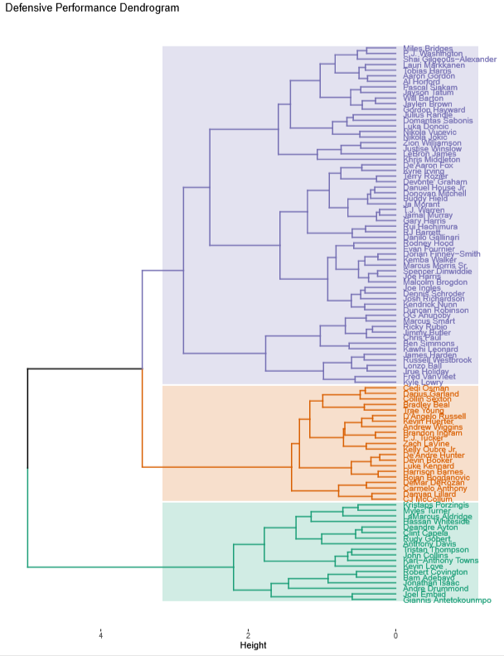
Compare/contrast to k means

Slide 24
Conclusions

Slide 25
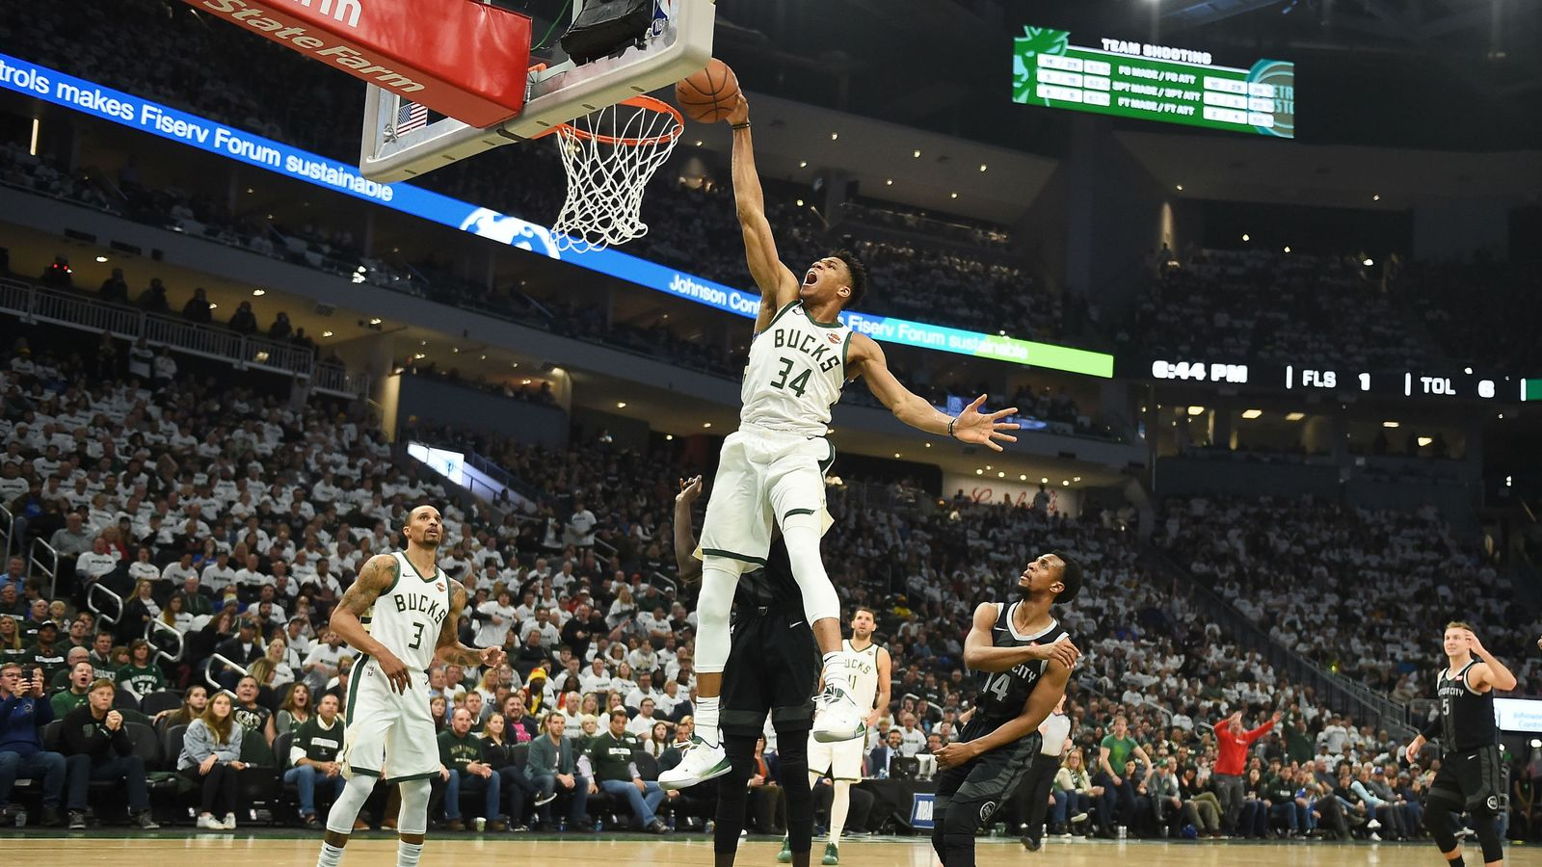
Overall Performance Clusters

Slide 26
Data Set Description
Variables – what is it – list out
Then
Note which variables used/removed/subset/data cleaning

Slide 27
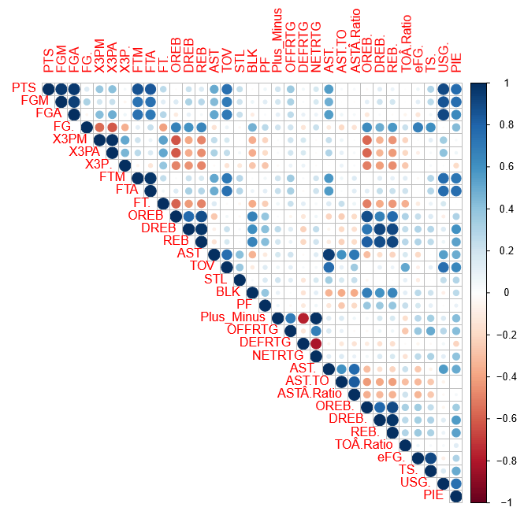
Corrplot
Takeaways
Takeaways

Slide 28
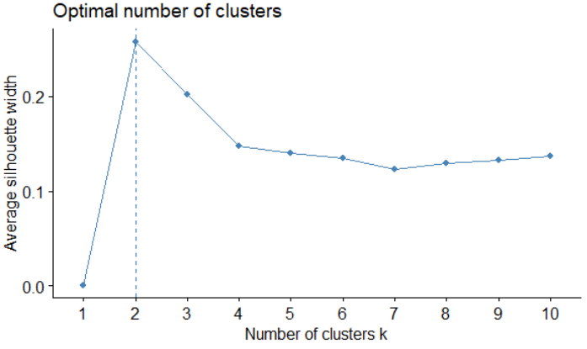
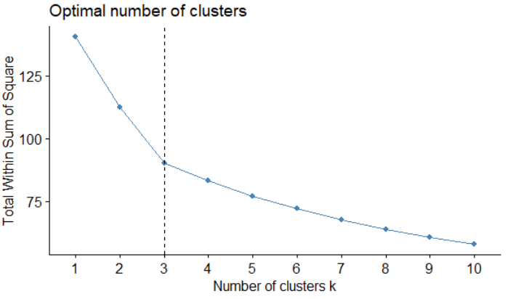
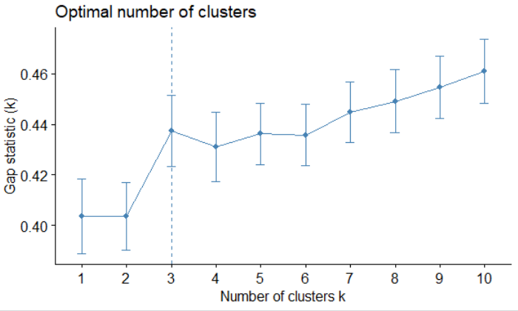
Cluster Optimization
Tagish line – describe different methods
Elbow Method
Silhouette Method
Gap Statistic Method
Total clusters and why----

Slide 29
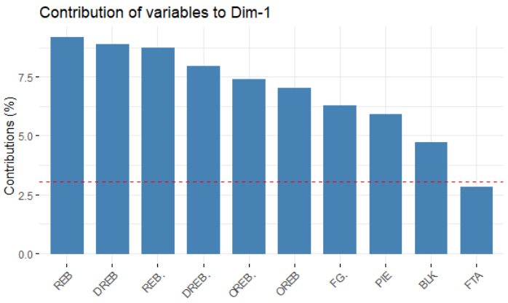
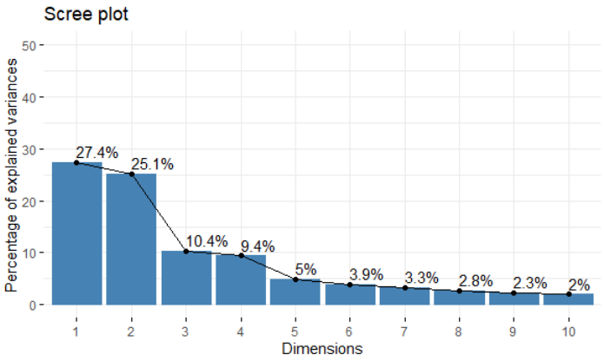
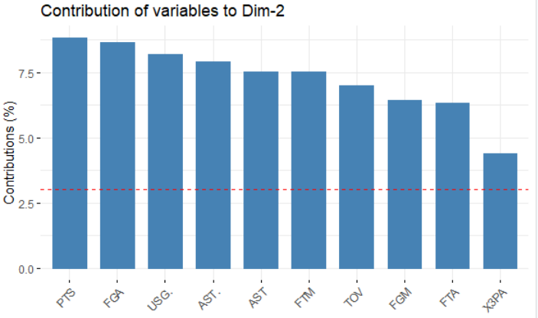
PCA

Slide 30
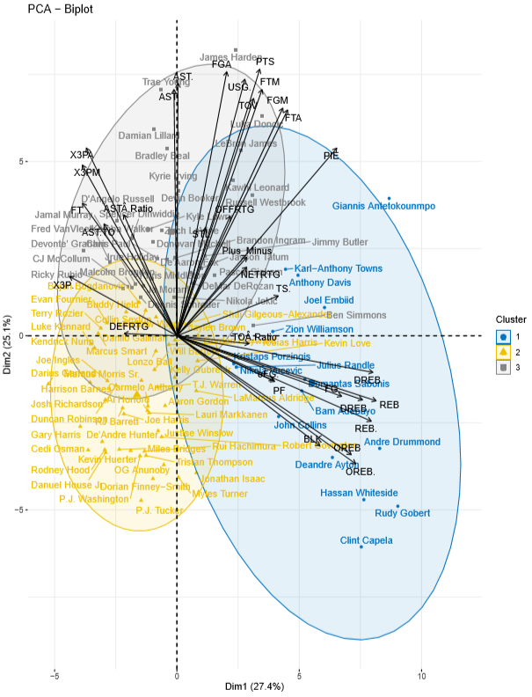
PCA

Slide 31
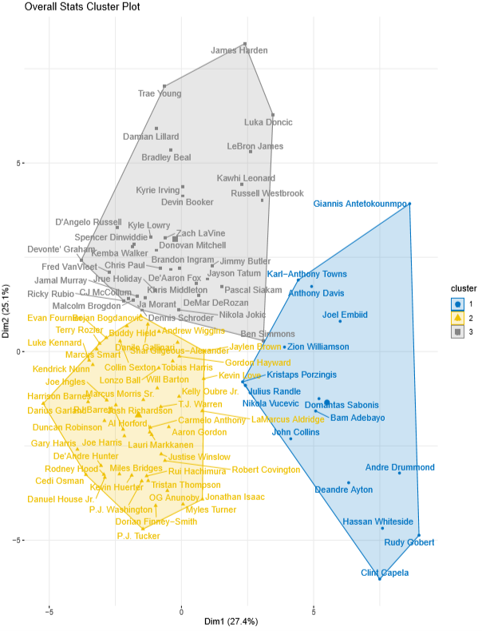
Cluster 1
Cluster 2
Cluster 3

Slide 32
Cluster Outcomes
Cluster 1 - Name
Cluster 2 - Name
Cluster 3 - Name
Describe playing style of cluster
Describe playing style of cluster
Describe playing style of cluster
Table with significant variables
Table with significant variables
Table with significant variables

Slide 33
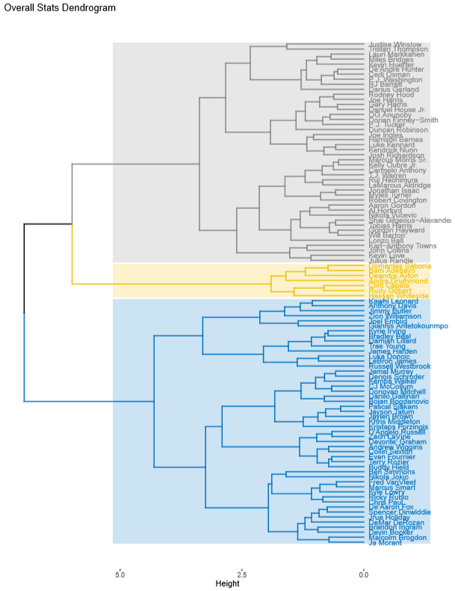
Compare/contrast to k means

Slide 34
Conclusions

Slide 35
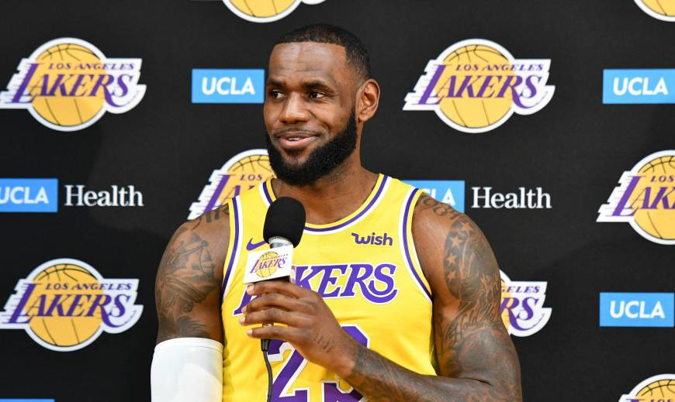
Conclusion

Slide 36
Pros/Cons
K means
HCA
PCA

Slide 37
Final Project Conclusions
1
2
3
4
5
6

Slide 38

The End
Questions?

Slide 39
References
All NBA pictures in deck found in ‘Images’ section on Google.com

Slide 40

Appendix

Slide 41
Tables with cluster data output - offense
Show as heatmap table

Slide 42
Tables with cluster data output - defense
Show as heatmap table

Slide 43
Tables with cluster data output - overall
Show as heatmap table

Slide 44
Delete slides below

Slide 45
Agenda
1
Introduction
2
Offensive Scoring
3
Defense Performance
4
Overall Stats
5
Conclusion

Slide 46
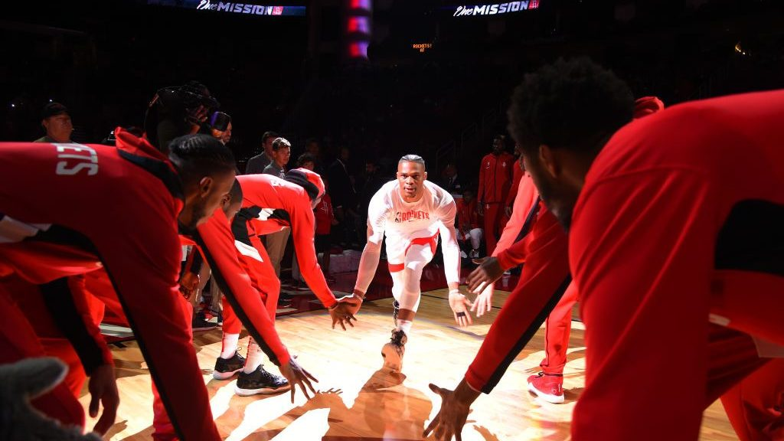
Necessary?
Introduction

